Slide 1
MyMess
A mobile app to ease out the selection process of mess meals in the campus
Aditi Shrivastava (2018201056)
PG-2

Slide 2
Proposed solution
We propose an android app through which the user can select mess registrations according to his/her food preferences. Preferences include flavors, cuisines, etc.
The app will show mess options based on user input preferences and then the user can finalize his/her choice.
After finalizing the choice, the app stores the mess selected by the user for the particular day and meal and this can be forwarded to the IIIT Mess website by connecting with the APIs of the IIIT Mess website for registration.

Slide 3
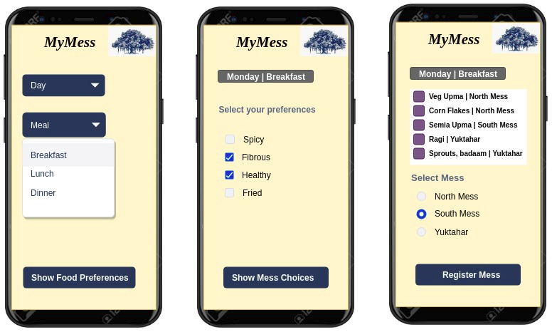

Slide 4
MyMess App

Slide 5
Use Cases:
User Registration
User Authentication
If user is authenticated:
(i) Selection of Day_Meal by the User
(ii) Display Tags according to the Day_Meal.
(iii)Tags Selection by the User and Display of the most relevant dishes(according to the tags match count of tags of dishes with the user selected tags).
(iv)Selection of Dish will take to the confirmation activity.
(v)Upon clicking the Register button, User will be registered for that mess for that particular Day_Meal.
Admin Section for Dish Entries

Slide 6
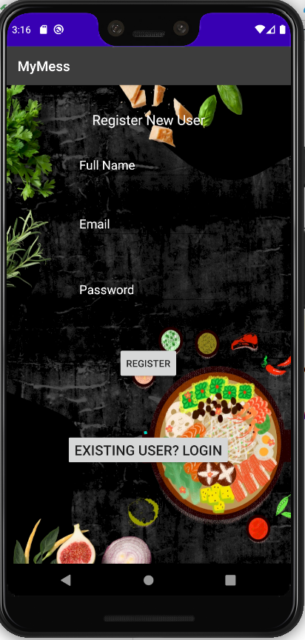
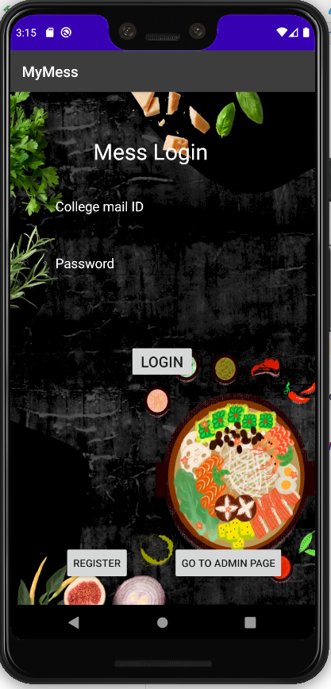
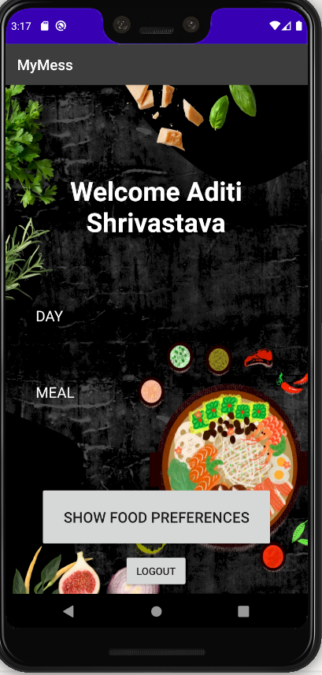

Slide 7
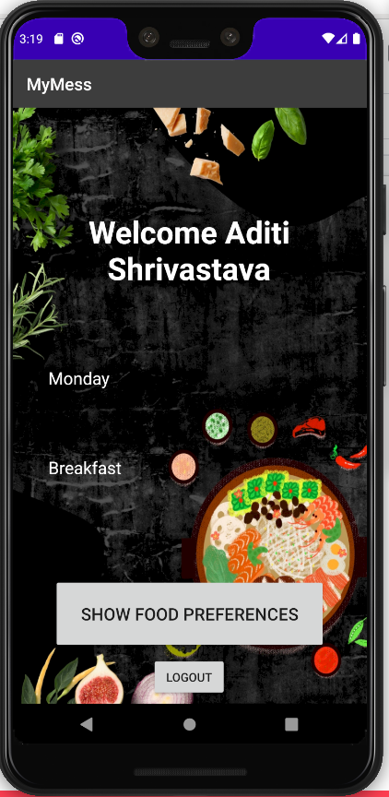
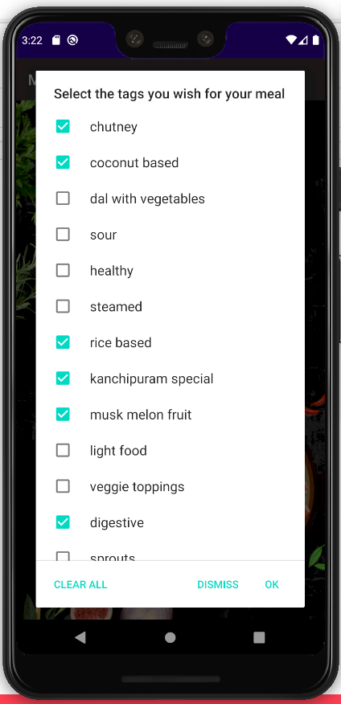
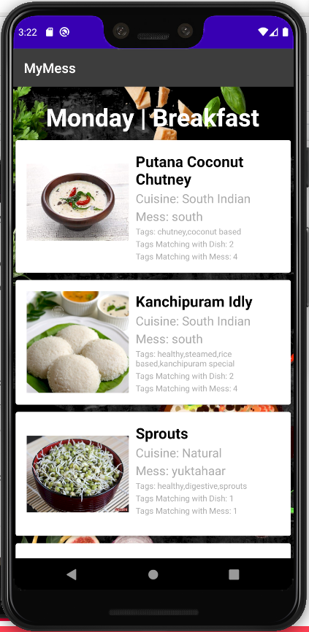

Slide 8
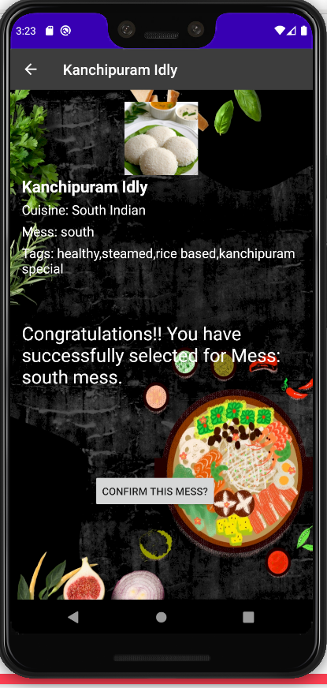
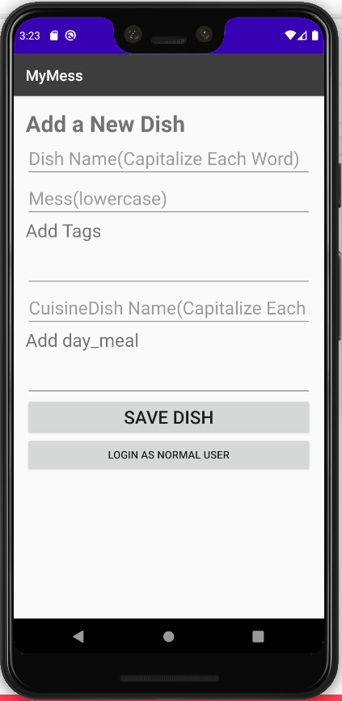
Admin Page=>

Slide 9
Why FireStore as the Database?
Login Flexibility
NoSQL Database
Fast Retrieval
Database on Cloud
Tags were unmanageable using SQL Database, very costly operations.
Data in the form of Containers and Documents.
Easy data management remotely

Slide 10
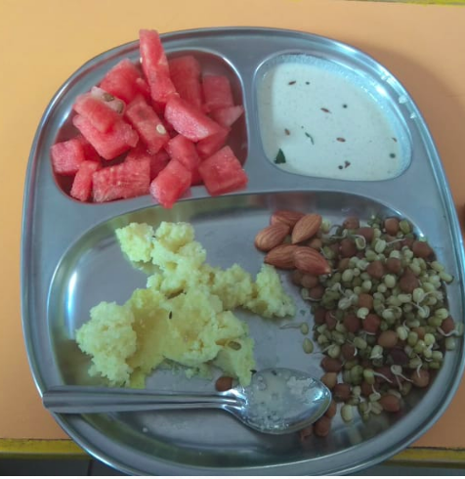
Future Scope
Assigning star ratings to meals and messes based on user feedback.
Mess Admins can push notifications about any change in menu, change in rates etc through the app.
Tags can be generated automatically by using ML modules.
Beta Testing

Slide 11
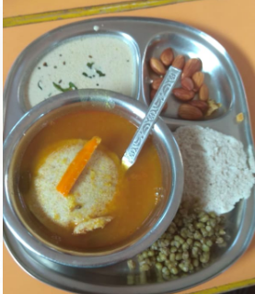
Thank You

